Slide 1
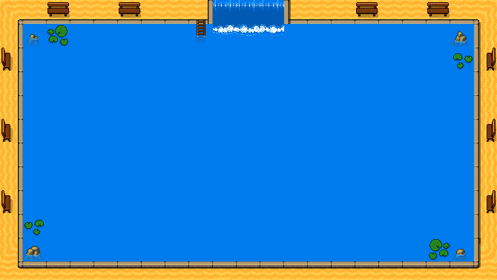

NORMANDA
-Logo under Development-

Slide 2
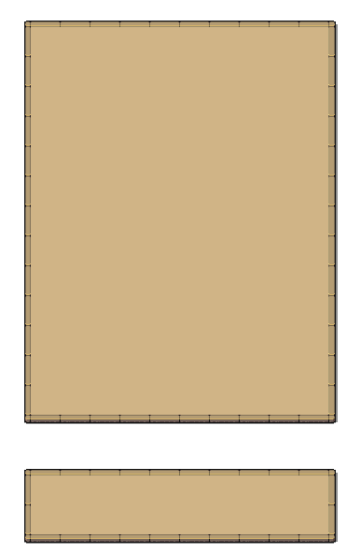
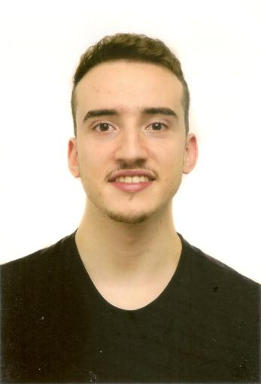
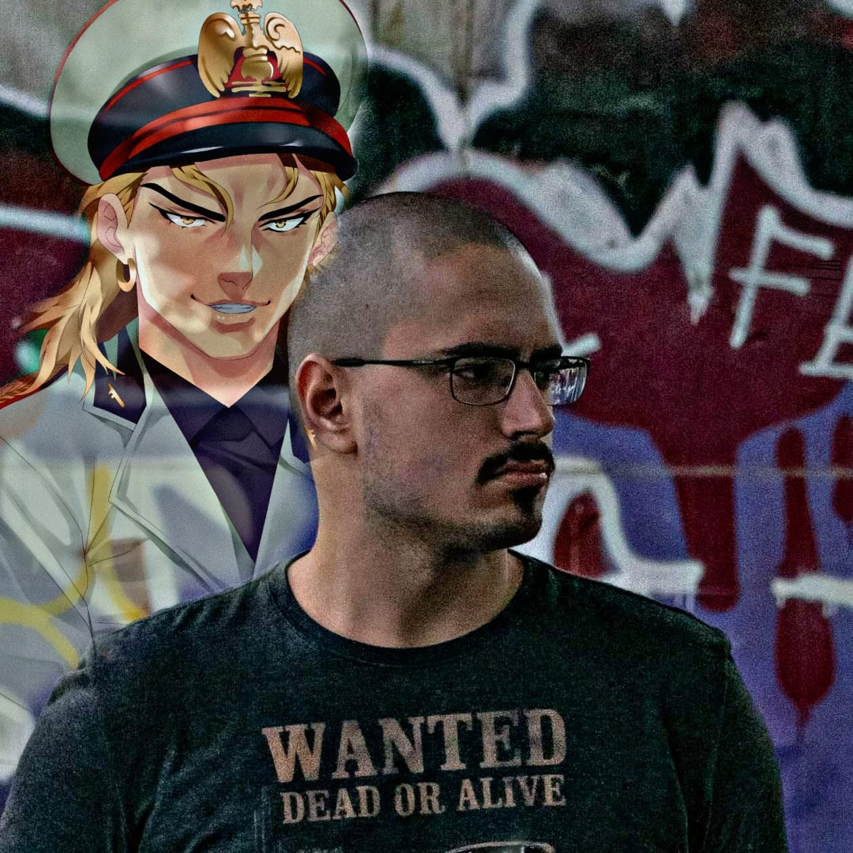
Gabriel Vergari
Nuno Teixeira

Slide 3
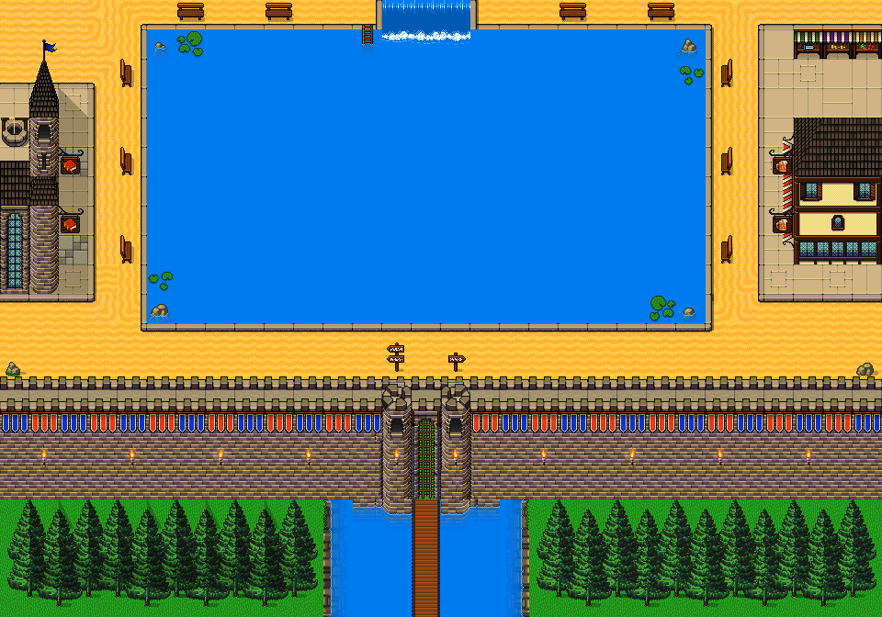
-2D Dungeon Crawler
-Singleplayer

Slide 4
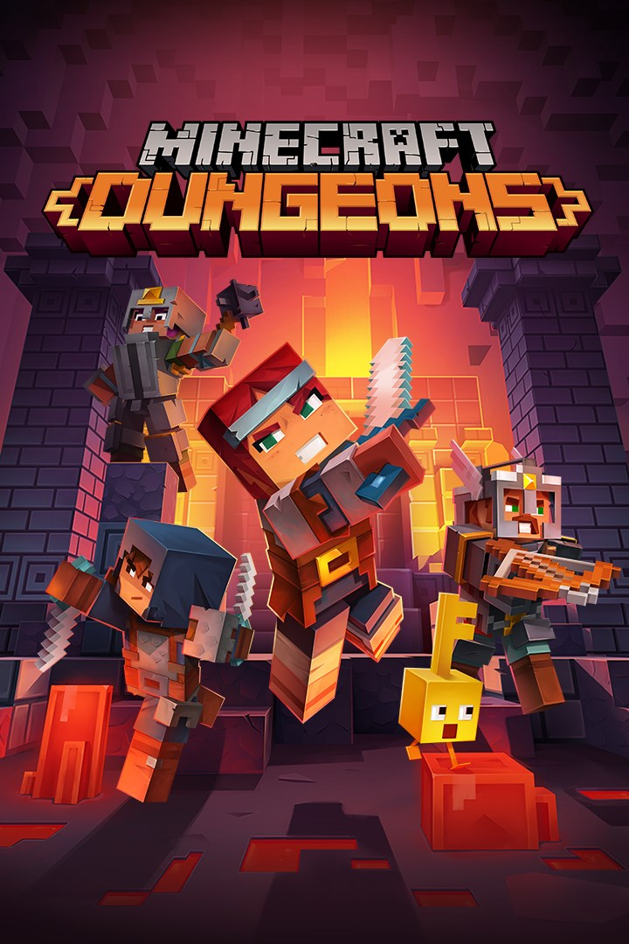
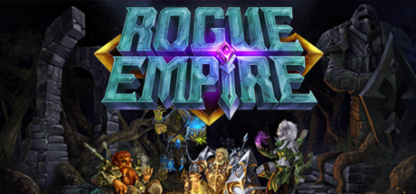

inspiration:

Slide 5
The game takes place in a castle.
Portals appear in the walls of the castle, showing the treat from the other world.

Slide 6
Player mechanics:

Slide 7
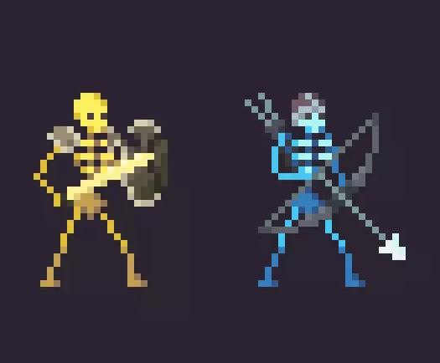
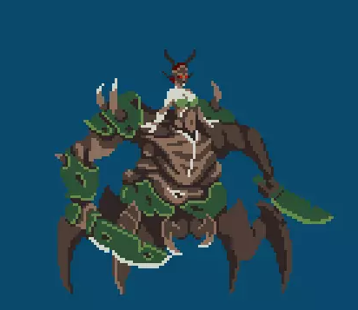
Enemies:
Normal Enemies:
Final Boss:

Slide 8
Companion app:
Inventory wiki
- Character stats - Training system

Slide 9
THANK YOU! Hope you like it!

